Slide 2
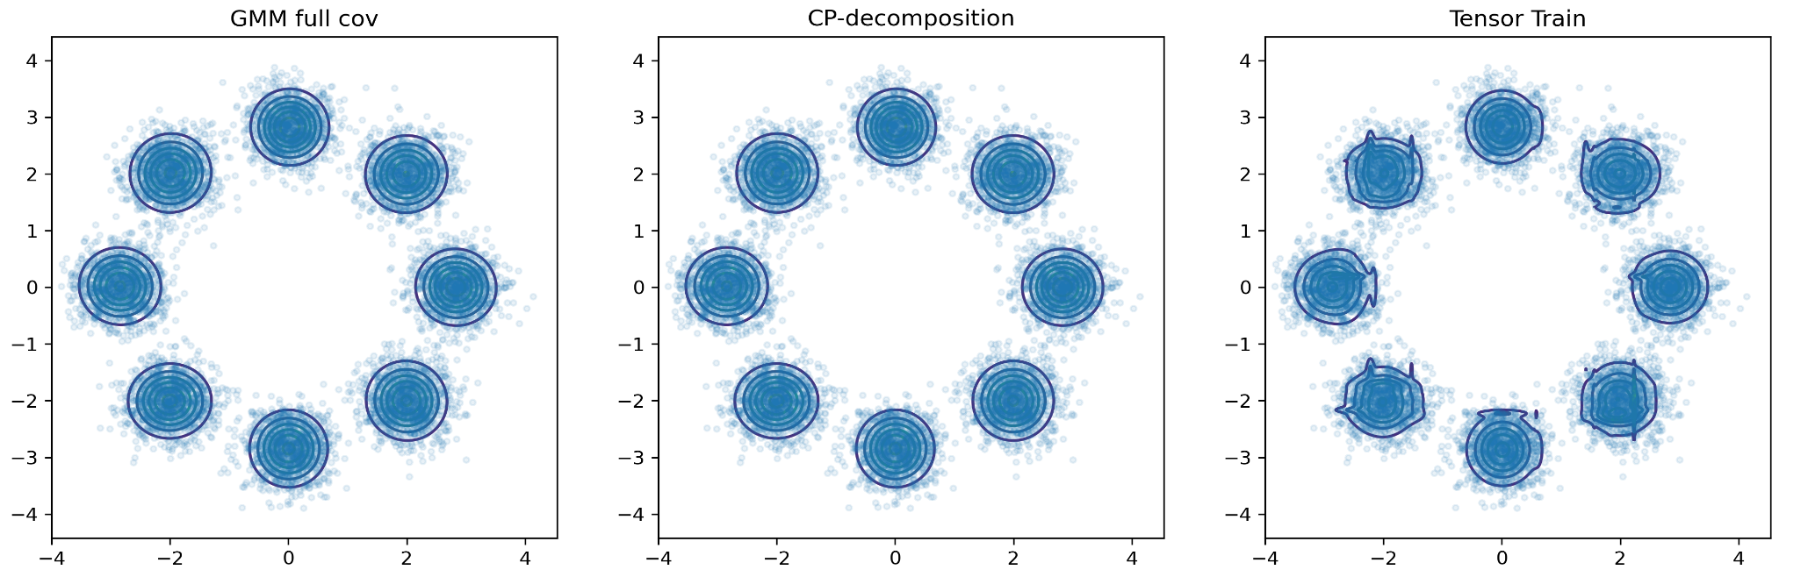
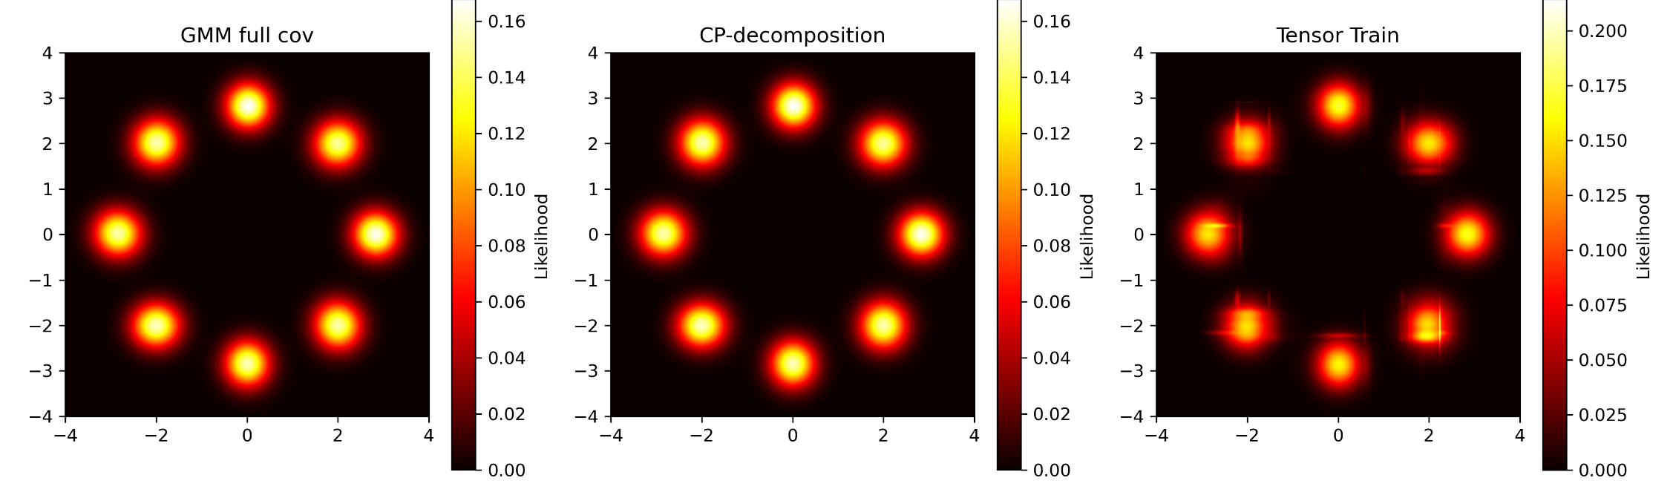
Comparaison of models : 8Gaussians (K=8, epochs = 1000)

Slide 3
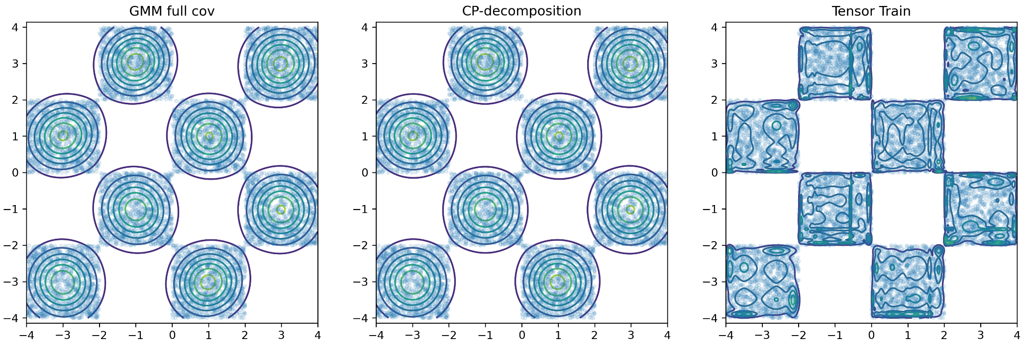
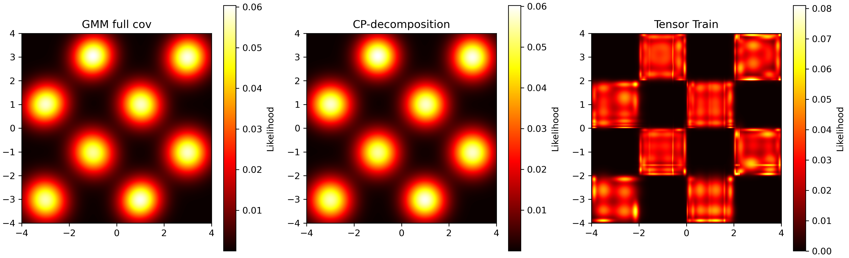
Comparaison of models : checkerboard (K=8, epochs = 1000)

Slide 4
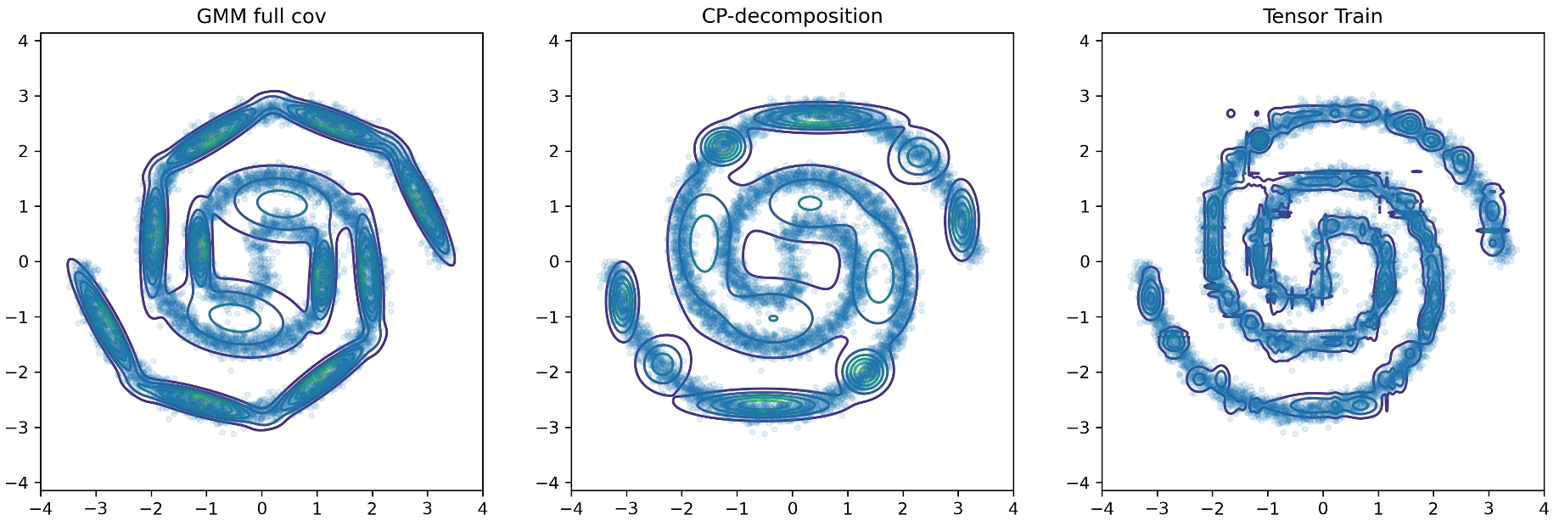
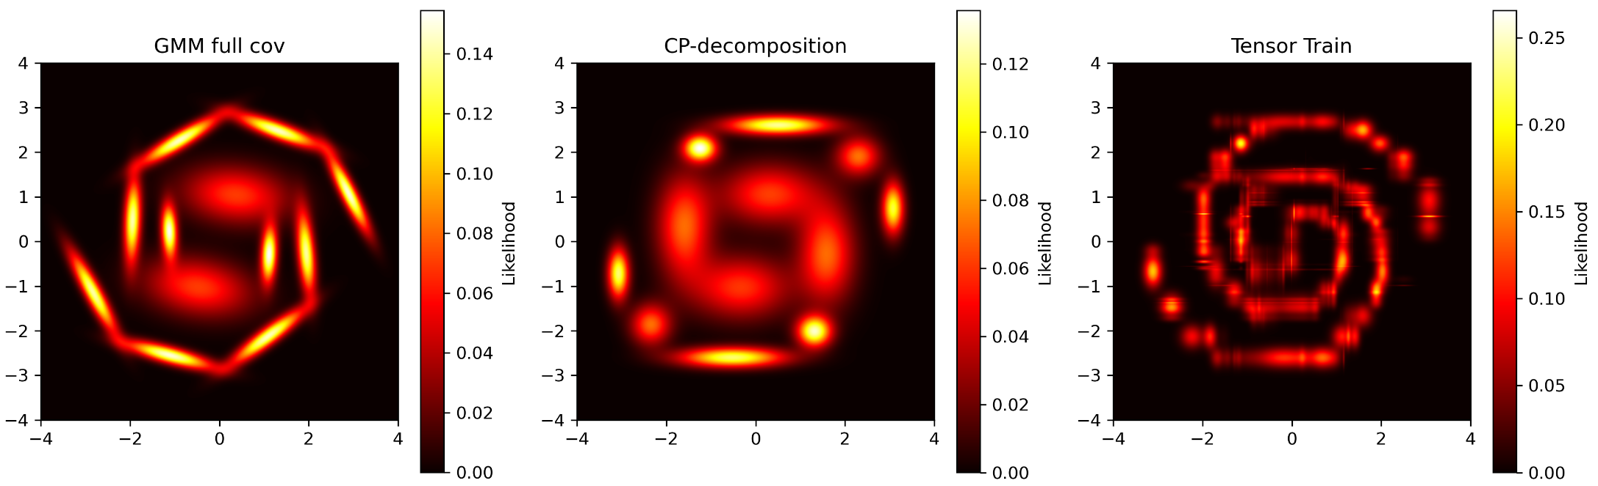
Comparaison of models : 2spirals (K=12, epochs = 1000)

Slide 5
Spørgsmål

